Slide 1
BRIDGES

Slide 2
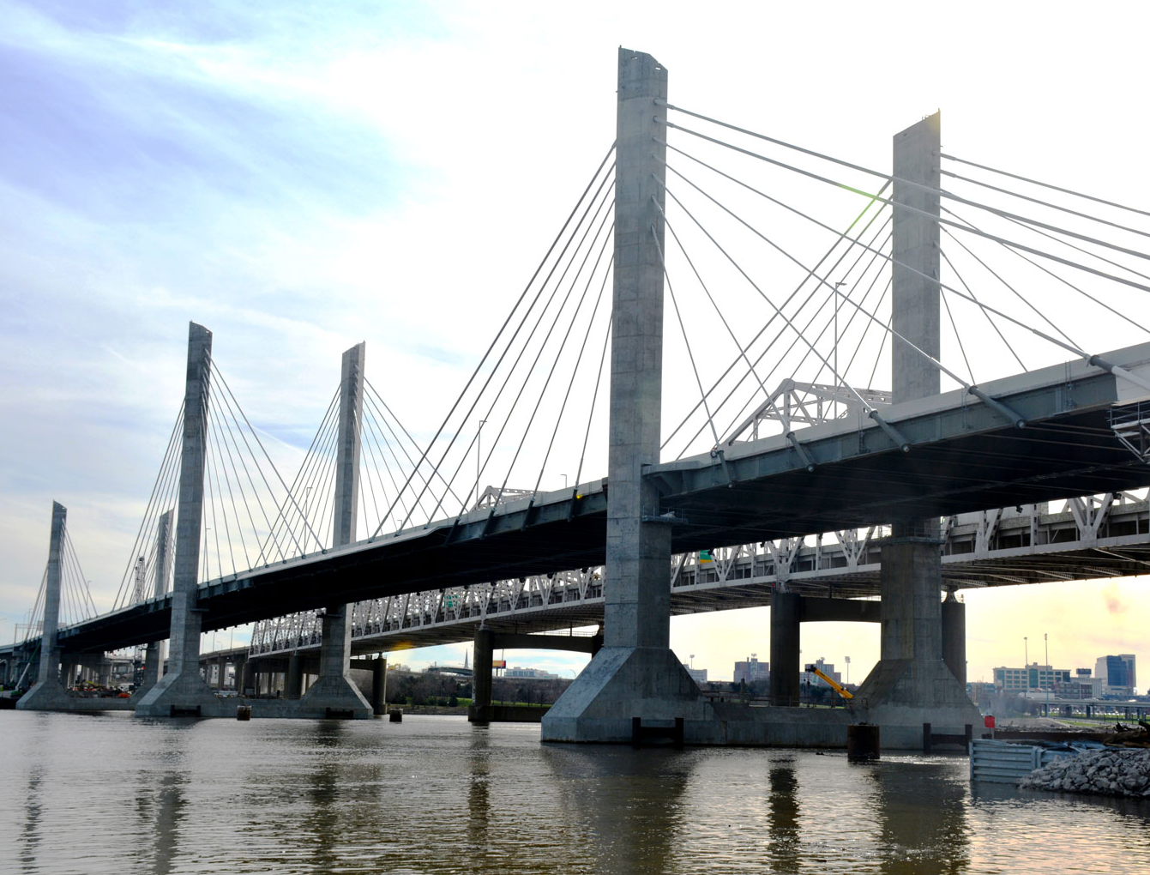
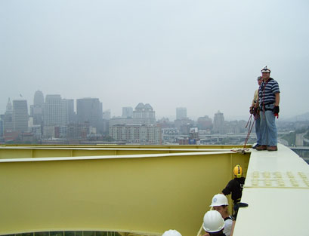
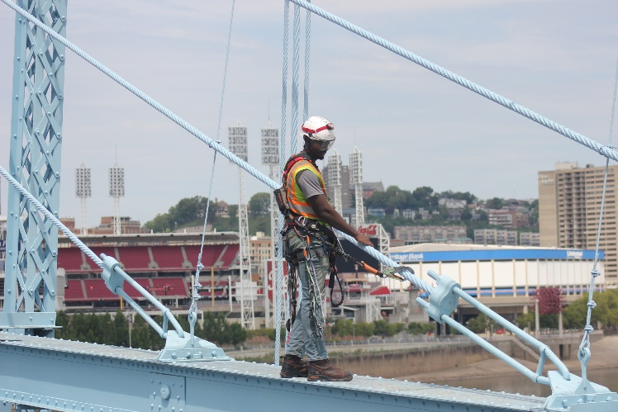
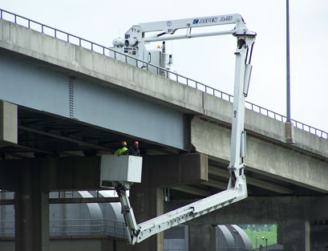

Slide 3
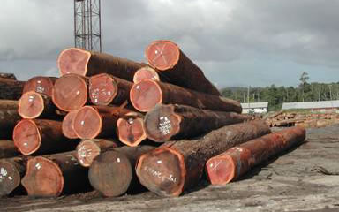
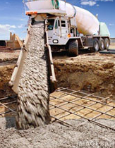
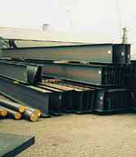
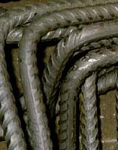
What are bridges made of?
Timber
Concrete
Steel

Slide 4
Types of bridges:
Beam/Girder Bridge
Truss Bridge
Arch Bridge
Suspension Bridge
Cable Stayed Bridge

Slide 5
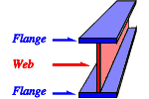
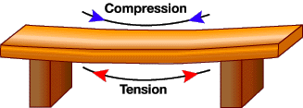
Beam/Girder Bridge

Slide 6
Beam/Girder Bridge
A Standard Beam and Girder Bridge in Northern Kentucky

Slide 7
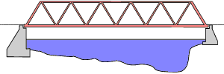
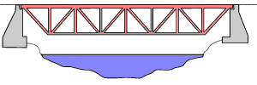
Truss Bridge

Slide 8
Truss Bridge (Through)
Purple People Bridge in Northern Kentucky

Slide 9
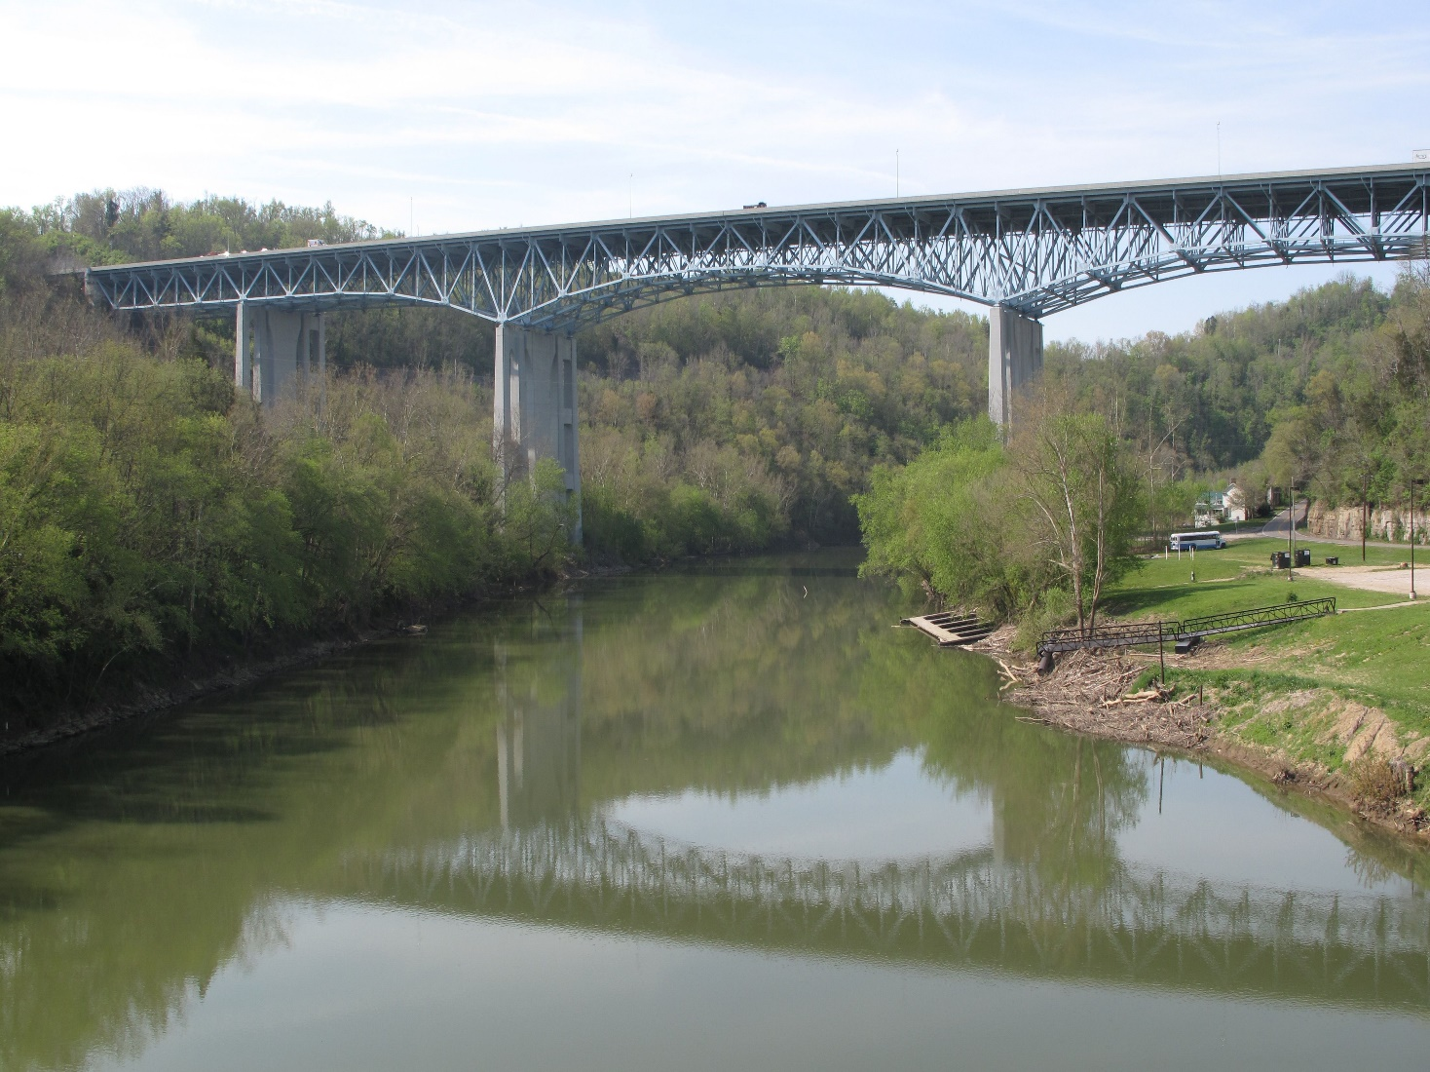
Truss Bridge (Deck)
Clay’s Ferry Bridge
(Halfway between Lexington and Richmond on I-75)

Slide 10
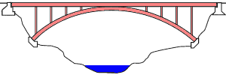
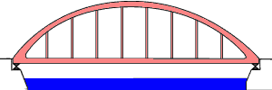
Arch Bridge

Slide 11
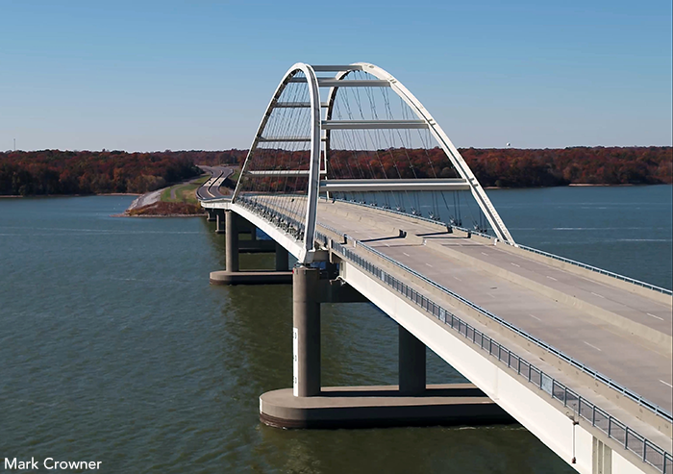
Arch Bridge (Through)
Eggner Ferry Bridge (Over Kentucky Lake near Paducah, KY)

Slide 12
Arch Bridge (Deck)
Deck Arch Bridge
in Northern Kentucky near Cincinnati

Slide 13
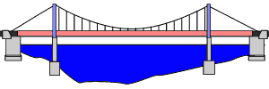
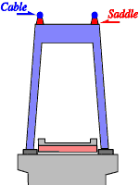
Suspension Bridge

Slide 14
Suspension Bridge
Roebling Suspension Bridge

Slide 15
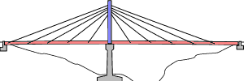
Cable Stayed Bridge

Slide 16
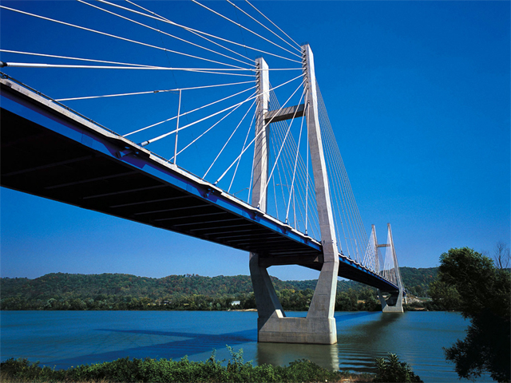
Cable Stayed Bridge
William H. Harsha Bridge
(Maysville, KY)

Slide 17
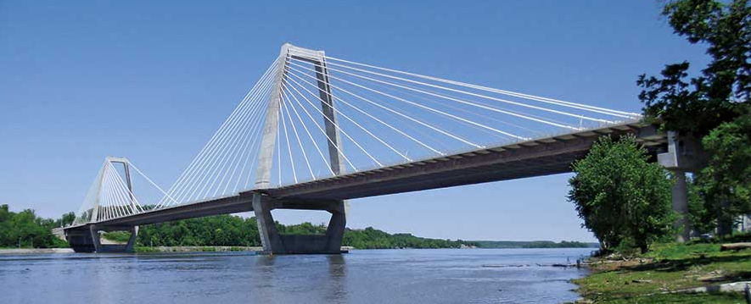
Cable Stayed Bridge
Lewis and Clark Bridge (Louisville, KY)

Slide 18
Email: KYTC.KEEN@ky.gov
Website: transportation.ky.gov/Education/Pages/KEEN.aspx

